Slide 1
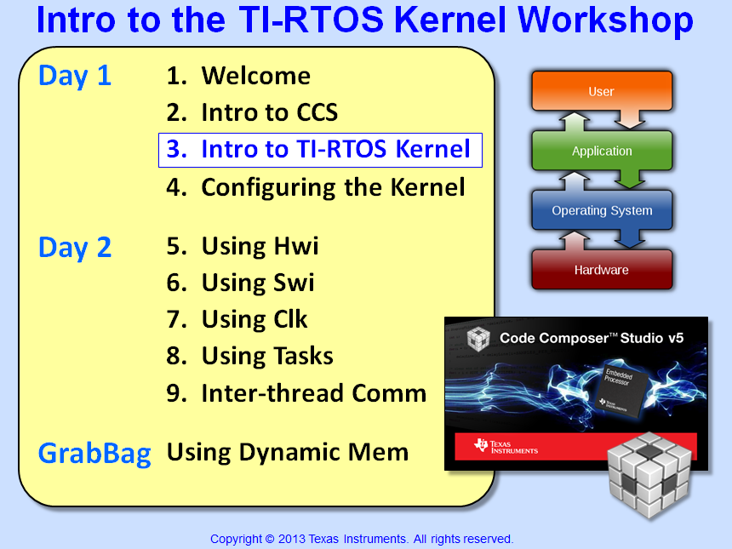

Slide 2
Objectives
Answer the question – “why use an RTOS?”
Explore the basics concepts of the TI-RTOS real-time kernel (SYS/BIOS)
Define kernel thread types and how the scheduler prioritizes threads in a system
Explain the types of debugging tools built into the TI-RTOS kernel
Quiz – Schedule the threads in a motor-control application

Slide 3
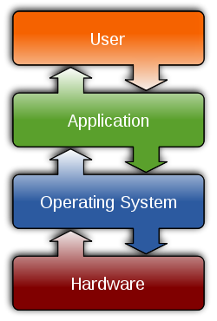
Outline
What is the TI-RTOS Kernel?
Scheduler
Adding Tasks…
BIOS Environment
BIOS Debugging Tools
For More Info…
Chapter Quiz

Slide 4
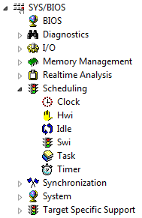

TI-RTOS Kernel Services
TI-RTOS Kernel (or SYS/BIOS) is a library of services that users can add to their system to perform various tasks:
Memory Mgmt (stack, heap, cache)
Real-time Analysis (logs, graphs, loads)
Scheduling (various thread types)
Synchronization (e.g. semaphores, events)
What does the DNA of this kernel look like?
TI-RTOS Kernel – Characteristics...

Slide 5
TI-RTOS Kernel – Characteristics
RTOS means “Real-time O/S” – so the intent of this O/S is to provide common services to the user WITHOUT disturbing the real-time nature of the system
The TI-RTOS Kernel (SYS/BIOS) is a PRE-EMPTIVE scheduler. This means the highest priority thread ALWAYS RUNS FIRST. Time-slicing is not inherently supported (can change PRI dynamically if desired).
The kernel is EVENT-DRIVEN. Any kernel-configured interrupts or user calls to APIs such as Swi_post() will invoke the scheduler. The kernel is NOT time-sliced although threads can be triggered on a time bases if so desired.
The kernel is OBJECT BASED. All APIs (methods) operate on self-contained objects. Therefore when you change ONE object, all other objects are unaffected.
Being object-based allows most RTOS kernel calls to be DETERMINISTIC. The scheduler works by updating event queues such that all context switches take the same number of cycles.
Real-time Analysis APIs (such as Logs) are small and fast – the intent is to LEAVE them in the program – even for production code – aides field testing
Let's take a closer look at one of the most useful parts of the kernel - the SCHEDULER...

Slide 6
Outline
What is the TI-RTOS Kernel?
Scheduler
Problem
Solutions
Adding Tasks…
BIOS Environment
BIOS Debugging Tools
For More Info…
Chapter Quiz

Slide 7
Outline
What is the TI-RTOS Kernel?
Scheduler
Problem
Solutions
Adding Tasks…
BIOS Environment
BIOS Debugging Tools
For More Info…
Chapter Quiz

Slide 8
Scheduling Problem – Two Threads
Problem Definition: you have two different threads that need to be serviced independently
TI MCU
Audio (100KHz)
KeyPad (10 Hz)
Will one routine conflict with the other?
How do you SCHEDULE each thread?
Is one “thread” higher PRIORITY than the other?
Let’s explore a few options we can use to SCHEDULE these two threads…

Slide 9
Outline
What is the TI-RTOS Kernel?
Scheduler
Problem
Solutions
Adding Tasks…
BIOS Environment
BIOS Debugging Tools
For More Info…
Chapter Quiz

Slide 10
Solution #1 – Super Loop
main()
{
while(1)
{
}
}
Solution #1 – put each algo into an endless loop in main()
What if algos run at different rates?
Audio
Audio – 100kHz (10μs)
KeyPad – 10Hz (100ms)
KeyPad
What if one starves the other or delays the response causing jitter/noise?
Could you use a TIMER to trigger each “thread” (or process) via an interrupt?

Slide 11
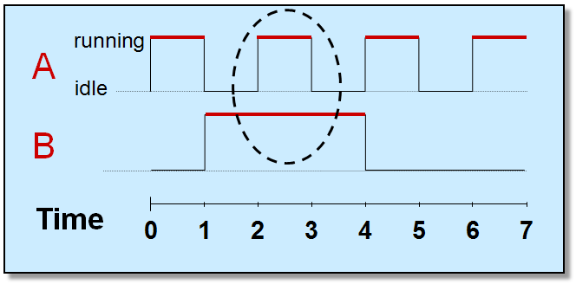
Solution #2 – Timer-based INTs
TimerA_ISR()
{
read sample;
}
Solution #2 – an interrupt driven system places each function in its own ISR
 | Period | Compute | Usage
Audio | 10μS | 5μS | 50%
Keypad | 100ms | 1ms | 1%
 |  |  | 51%
Audio
TimerB_ISR()
{
read keypad;
}
While CPU usage is fine, one interrupt may block the other (instantaneous):
KeyPad
Interrupt is missed
main()
{
while(1);
}
How could we prevent this?

Slide 12
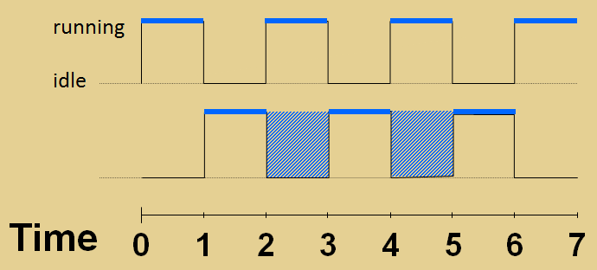
Solution #3 – Nested INTs
TimerA_ISR()
{
read sample;
}
Solution #3 – nested interrupts allow hardware interrupts to preempt each other
Audio
A
B
TimerB_ISR()
{
read keypad;
}
KeyPad
Number of priorities are tied to the number of interrupts (one fxn/ISR), h/w priorities inflexible
Lower priority ISRs must enable higher priorities via manual code (touch one, touch all) – very messy and hard to validate
main()
{
while(1);
}
Why is nesting required in this system?

Slide 13
Solution #4 ? – Separate Process & ISR
TimerA_ISR()
{
read sample;
}
Problem – nested interrupts are used because “Process” (algo) is done IN the ISR !
When HI PRI is running, you could STILL miss interrupts:
Audio
C/S
Nest?
Hard
Real
Time
(Read)
Process Data
C/R
TimerB_ISR()
{
read keypad;
}
Global ints disabled
KeyPad
What if we could separate the PROCESS from the rest of the ISR?
C/S
Nest?
Hard
Real
Time
(Read)
Post
Swi
C/R
Process Data
(in Software Interrupt)
main()
{
while(1);
}
Global ints disabled
rather than all this time
This is what the BIOS Scheduler is all about…

Slide 14
Solution #4 – BIOS Scheduler
Audio_ISR()
{
read sample;
post_Audio;
}
Hwi – Hardware INT
Context save/restore (done by BIOS)
Hard real-time “read”
Post Swi for follow-up
HI
If we can DECOUPLE the processing from the TRIGGER (Hwi):
ISRs become VERY short (no need for nesting)
Configure PRIs of threads via software
Add as many threads as we need (no limit)
Touch ONE, no CODE changes to the others !
Keypad_ISR()
{
read keypad;
post_KeyPad;
}
Swi – Software INT
Posted by software
PROCESS data
User can select priority
main()
{
init_stuff;
while(1);
BIOS_start();
}
Idle – Background
Runs multiple fxns inside of a while(1) loop
LO
What is the difference between a THREAD and a FUNCTION ?

Slide 15

“Thread” vs. Function
Thread wrapper (C/S)
A function is a set of program instructions that produce a given result.
void my_fxn()
{
int m, x, b;
int y;
y = m*x + b;
serial = y;
results += 1;
}
If you look at this function, can you tell what priority it is running at?
A thread is a function that runs within a specific context (PRIORITY, stack, etc.)
Thread wrapper (C/R)
my_fxn() could run as ANY thread type (e.g. Swi_1 or Hwi_1)
User selects thread GROUP (and PRI w/in group), BIOS executes it
Hwi
High Priority ISR
Calls my_fxn()
Swi
Follow-up to Hwi
Calls my_fxn()
Idle
Lowest PRI
Calls my_fxn()
Priority
Let’s see a scheduling example of these 3 threads…

Slide 16
BIOS – Priority Based Scheduling
post3
rtn
Audio_ISR()
{
read_sample();
Swi_post(Swi_2);
}
Hwi 2
Hwi 1
Swi 3 (Hi)
Swi 2
Swi 1 (Lo)
main
Idle
post2
rtn
post1
rtn
Posted
Running
int2
rtn
Ready
rtn
start
int1
User SETs the priorities, BIOS executes them
Notes:
Using Clock Fxns in a Task-based video system is not really recommended because Clock Functions will ALWAYS have a higher priority than TSKs because periodic functions s are prioritized as Swis.

Slide 17
Outline
What is the TI-RTOS Kernel?
Scheduler
Adding Tasks…
BIOS Environment
BIOS Debugging Tools
For More Info…
Chapter Quiz

Slide 18
SYS/BIOS Thread Types (including Tasks)
Hwi
Hardware Interrupts
Hardware event triggers Hwi to run
BIOS handles context save/restore, nesting
Hwi triggers follow-up processing
Priorities set in silicon
Swi
Software Interrupts
Software posts Swi to run
Performs Hwi ‘follow-up’ activity (process data)
Up to 32 priority levels (16 on C28x/MSP430)
Priority
Task
Tasks
Usually enabled to run by posting a ‘semaphore’ (a task signaling mechanism)
Designed to run concurrently – pauses when waiting for data (semaphore)
Up to 32 priority levels (16 on C28x/MSP430)
Idle
Background
Runs as an infinite while(1) loop
Users can assign multiple functions to Idle
Single priority level
A little more info about Tasks...
Notes:
Using Clock Fxns in a Task-based video system is not really recommended because Clock Functions will ALWAYS have a higher priority than TSKs because periodic functions s are prioritized as Swis.

Slide 19
How Tasks Work…
Tasks are just a function that run in a while(1) loop and contain a blocking call that waits for a signal
When the task is BLOCKED (e.g. waiting for “buffer ready” signal), lower priority threads can run
Another thread (e.g. Hwi) posts a signal to UNBLOCK the Task which triggers the execution of “Process Data”
The code then loops back and BLOCKS again – waiting for signal
Blocking requires each Task to have its own private stack.
Task
Hwi_ISR:
POST SIGNAL
start
BLOCK waiting for signal
Pause
(blocked state)
loop
“Process Data”
end
Private Stack
(Task)
Note: we have entire chapters dedicated to exploring both Swi’s and Tasks

Slide 20
TI-RTOS Kernel Services – Summary
You have now been exposed to the following thread types:
Idle (Chapter 4)
Hwi (Chapter 5)
Swi (Chapter 6)
Task (Chapter 8)
Each of these thread types have their own chapter along with:
Memory Mgmt (stack, heap) – “Dyn Mem” chapter (optional)
Real-Time Analysis (logs, graphs, loads) – (Chapter 4)
Clock/Timer – (Chapter 7)
Synchronization (semaphores, events) – (Chapter 8)
Let's take a look at the BIOS environment...

Slide 21
Outline
What is the TI-RTOS Kernel?
Scheduler
Adding Tasks…
BIOS Environment
BIOS Debugging Tools
For More Info…
Chapter Quiz

Slide 22
Kernel APIs, Objects and Handles
BIOS is object oriented – each module is created as an object and objects are accessed via the API:
Audio_ISR() {
Hard real_time access;
Swi_post (AudioSwi);
}
API
Swi_Handle
typedef struct SwiObj {
AudioSwi; // handle
Audio_fxn; // fxn
2; // Priority
};
Better encapsulation
Change one w/o affecting others
Multiple instances
Easy to maintain, validate
How do you create a Swi object ?

Slide 23
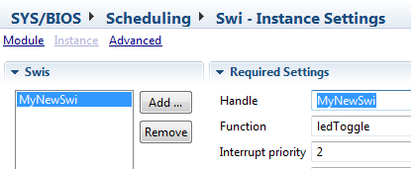
Thread (Object) Creation in TI-RTOS
Users can create threads (BIOS resources or “objects”):
Statically (via the GUI or .cfg script)
Dynamically (via C code) – more details in the “memory mgmt” chapter
BIOS doesn’t care – but you might…
Dynamic (C Code)
Static (GUI or Script)
#include <ti/sysbios/knl/Swi.h>
Swi_Params swiParams; Swi_Params_init(&swiParams);
swiParams.priority = 2; Swi_create(ledToggle, &swiParams, NULL);
app.c
Note: more details on BIOS config in the next chapter…
var Swi = xdc.useModule('ti.sysbios.knl.Swi');
var swi0Params = new Swi.Params();
swi0Params.instance.name = "MyNewSwi";
swi0Params.priority = 2;
Program.global.MyNewSwi = Swi.create("&ledToggle", swi0Params);
app.cfg
TI-RTOS Kernel Debugging Tools…

Slide 24
Outline
What is the TI-RTOS Kernel?
Scheduler
Adding Tasks…
BIOS Environment
BIOS Debugging Tools
For More Info…
Chapter Quiz

Slide 25
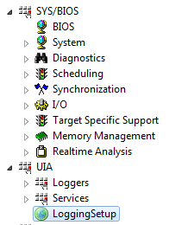
Built-in Debug Tools (UIA & ROV) – Intro
UIA - Unified Instrumentation Architecture tools provide visibility into what is going on in your system:
Logging – “printf()-lite”
Execution Graph – software “logic analyzer”
Load – CPU/Thread loading
UIA replaces the older RTA tools – requires “LoggingSetup”
ROV – RTOS Object Viewer – see status of BIOS objects in your system (when halted)
Let's look at what these tools look like in CCS...

Slide 26
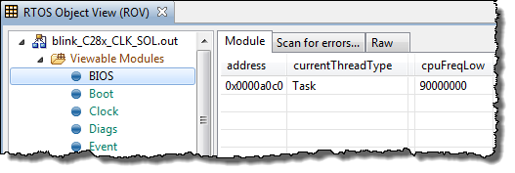
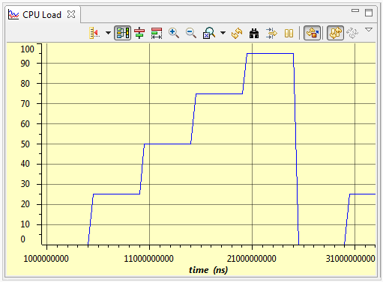
ROV and UIA – Visibility/Debug Tools
Gather data on target (30-40 CPU cycles)
Format data on host (1000s of host PC cycles)
Data gathering does NOT stop target CPU
Halt CPU to see results (stop-time debug)
Real-time is…
RTOS Obj Viewer (ROV)
Halt to see results
Displays stats about all threads in system
CPU/Thread Load Graph
Analyze time NOT spent in Idle

Slide 27
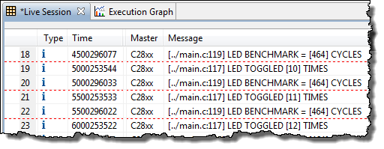
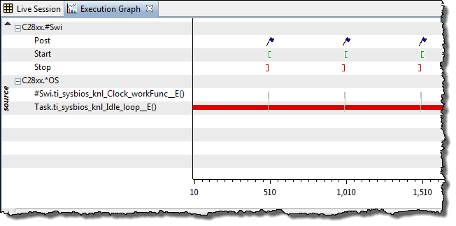
ROV and UIA – Visibility/Debug Tools
Logs
Send DBG Msgs to PC
Data displayed during stop-time
Deterministic, low CPU cycle count
WAY more efficient than traditional printf()
Log_info1(“LED TOGGLED [%u] times”, count);
Execution Graph
View system events down to the CPU cycle…
Calculate benchmarks
Note: more details on how to configure these tools in the next chapter…
time(ms)

Slide 28
Outline
What is the TI-RTOS Kernel?
Scheduler
Adding Tasks…
BIOS Environment
BIOS Debugging Tools
For More Info…
Chapter Quiz

Slide 29
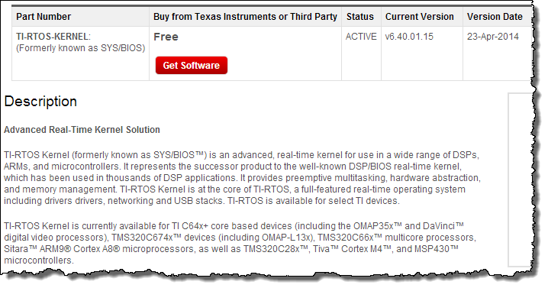
For More Information
TI-RTOS Kernel Product Page (www.ti.com/sysbios)

Slide 30
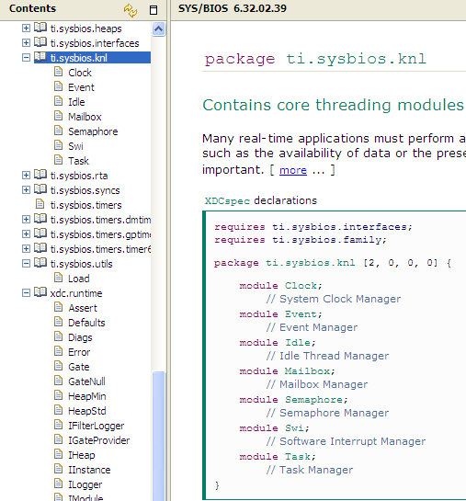
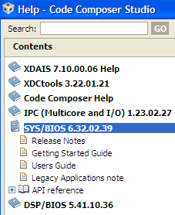
For More Information (2)
CCS Help Contents
User Guides
API Reference (knl)

Slide 31
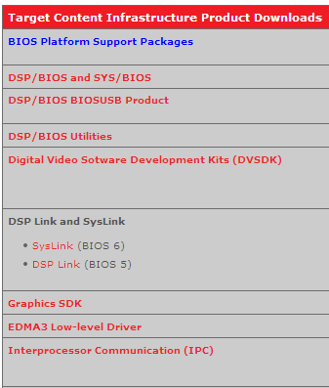
Download Latest Tools
Download Target Content
http://software-dl.ti.com/dsps/dsps_public_sw/sdo_sb/targetcontent/
DSP/BIOS
SYS/BIOS
Utilities
SysLink
DSP Link
IPC
Etc.

Slide 32
Outline
What is the TI-RTOS Kernel?
Scheduler
Adding Tasks…
BIOS Environment
BIOS Debugging Tools
For More Info…
Chapter Quiz

Slide 33
Quiz – Block Diagram
H/W
CPU
Position
S/W
PWM P
Bridge
Keypad
Host
LED
I2C
PWM S
Speed
I2C
PIDx2
Motor
GPIO
Sys Maint
ADC S
Sensors
ADC P
Basic Motor Control System
Goal – Control motor speed/position via PID algo based on ADC info and output control to PWM
Other services include: Keypad, LED, Host, System Maintenance
Quiz
Fill in the missing info in the tables (next page) regarding HOW to schedule the threads in the system
Think about Priority and the TYPE of BIOS thread you would assign to each

Slide 34
Quiz – Fill in the missing pieces…
System Threads
Hwi’s | S/W function | BIOS Thread Type | S/W Priority?
ADC_P_ISR | PID_Position |  | High -
ADC_S_ISR | PID_Speed
Host_ISR | Host_Cmd_Proc |  | Med -
Keypad_ISR | Keypad_Read |  | Low -
LED_blink_ISR | LED_toggle
 | Sys_maint |  | Lowest -
Hwi’s: triggered by interrupt, ISR called via BIOS Hwi.
S/W function: called by “BIOS Thread Type” (e.g. Swi 5 calls PID_Position)
BIOS Thread Type: choices are – Hwi, Swi, Task, Idle
S/W Priority: Swi (0-15/31), Task (0-15/31), Idle (0)
Bonus Question
If you had ONE timer and needed to run 5 different threads based off that timer, how would you accomplish this?
Click for ALL answers...

Slide 35
Quiz – One “Solution”
System Threads
Hwi’s | S/W function | BIOS Thread Type | S/W Priority?
ADC_P_ISR | PID_Position | Swi | High – Swi 5
ADC_S_ISR | PID_Speed | Swi | Swi 3
Host_ISR | Host_Cmd_Proc | Task | Med – Task 5
Keypad_ISR | Keypad_Read | Task | Low – Task 3
LED_blink_ISR | LED_toggle | Task | Task 2
 | Sys_maint | Idle | Lowest – Idle
Hwi’s: triggered by interrupt, ISR called via BIOS Hwi.
S/W function: called by “BIOS Thread Type” (e.g. Swi 5 calls PID_Position)
BIOS Thread Type: choices are – Hwi, Swi, Task, Idle
S/W Priority: Swi (0-15/31), Task (0-15/31), Idle (0)
Bonus Question
If you had ONE timer and needed to run 5 different threads based off that timer, how would you accomplish this? Use BIOS Clock Functions.

Slide 36


Slide 37
Swi’s and Tasks
Swi
Swi_post (Swi);
Task
Semaphore_post (Sem);
start
Semaphore_pend
System Stack
(Hwi/Swi)
Pause
“run to
completion”
(blocked state)
start
Private Stack
(Task)
end
end
Similar to hardware interrupt, but triggered when posted
All Swi’s share system software stack with Hwi’s
Context (init code at start) is not preserved between calls
Designed to run concurrently
Unblocking (via flag) triggers execution
Each Task has its own stack, which allows them to pause (i.e. block)
Topology: prologue, loop, epilogue…

Slide 38
Thread Preemption Example
post swi1
return
post swi2
return
post sem2
return
Hwi
return
Swi 2
return
Swi 1
pend sem2
pend sem2
interrupt
Task 2
pend sem1
Task 1
interrupt
interrupt
BIOS_start()
Idle
Events over time
Note: Tasks run when Scheduler starts and are always pre-empted by Swi’s
Notes:
The main point of this slide is that BIOS (scheduler) manages priorities for you. Each thread (SWI, TSK) runs unaware of the others around it. As INTs post SEMs and SWIs, higher priority threads become ready, and BIOS will run each in order of priority, dropping down to lower levels as higher ones are satisfied or block waiting for additional resources. All this is automatic to the user - just write each thread, assign it a priority, and BIOS does the rest.
A few points to note: SWIs run to completion - like a function call - a one shot, if you like. TSKs, instead, usually linger much longer - their execute phase is a while loop. They block when they run out of resources, and lower threads (or idle) can run until the requested resource arrives. In Bridge, TSKs are dynamically created and can be deleted, but normally are ready, running, or blocked.
An interesting point: if RMS is a TSK of low priority (1), how come it’s running when TSK1 and TSK2 are ready? Recall that RMS implements the create phase of each TSK, and until the gateway puts the TSK in run mode, its priority is (minus) -1, thus TSK1 and TSK2 have no priority until elevated with DSPNode_run().

Slide 39
“Thread” vs. Function
Thread wrapper (C/S)
A function is a set of program instructions that produce a given result.
void my_fxn()
{
int m, x, b;
int y;
y = m*x + b;
serial = y;
results += 1;
}
If you look at this function, can you tell what priority it is running at?
A thread is a function that runs within a specific context (PRIORITY, stack, etc.)
Thread wrapper (C/R)
my_fxn() could run as ANY thread type
User selects thread GROUP (and PRI w/in group), BIOS executes it
Hwi
High Priority ISR
Calls my_fxn()
Swi
Follow-up to Hwi
Calls my_fxn()
Task
“Blocking” thread
Calls my_fxn()
Idle
Lowest PRI
Calls my_fxn()

Slide 40
Outline
MainHighlight
MainNormal
SubHighlight
SubNormal

